Slide 1

Kickstarter Success Predictor
Siddharth Jhaveri
Ishan Khedkar
Yash Kantharia
Shubham Joshi
Department of Information Technology,
St. Francis Institute of Technology

Slide 2

Contents
Introduction
Review of literature
Problem definition
Proposed solution
Scope of project
Hardware & software requirements
Project block diagram
Implementation (GUI)

Slide 3
Introduction
Kickstarter is one of the most popular a crowdfunding platforms on the internet.
The main purpose of the project is to generate the closest and most accurate probability for a Kickstarter crowd-funding campaign before it starts its funding.
The basis for our work was drawn from a paper by three students from UCSD, on Prediction of success rate of a campaign based on their Kickstarter dataset consisting of 1,30,000 campaign’s data.

Slide 4
Review of literature
# | Paper | Description
[1] | N. Hussain, K. Kamel and A. Radhakrishna. ”Predicting the success of Kickstarter cam- paigns”, Cseweb.ucsd.edu, 2018. | Hussain, Kamel and Radhakrishna used various types of algorithm on complex and simple features to divide parameters. They also suggested that any boosting method will improve accuracy.
[2] | Li, Rakesh & Reddy. ”Project Success Prediction in Crowdfunding Environments”. Ninth ACM International Conference on Web Search and Data Mining, pp. 247-256, CA, USA. (c) (2016)ACM. | Li, Rakesh and Reddy used both classification and regression. They conclude that log logistic method is more accurate approach and also stated that overall run of project depends on first three days of its funding stage.
[3] | R. Kamath and R. Kamat. ”Supervised Learning Model For Kickstarter Campaigns With R Mining”, International Journal of Information Technology, Modeling and Computing (IJITMC) Vol. 4, No.1,17-28, February 2016. | Kamath and Kamat used R libraries and different classifier models and concluded that neural network and Naïve Bayes gives improved accuracy up to 94%.

Slide 5
Problem definition
It is very difficult to predict the future of a project, and often very time consuming. Without any proper measures for probability of success it becomes difficult for investors to trust the Kickstarter campaign and invest in them. The failure of any project can be due to inefficient planning or on the market conditions.

Slide 6
Proposed solution
There are multiple factors by which success of a Kickstarter campaign could be interpreted.
We propose to develop a machine learning model which can predict the probability of success of any Kickstarter campaign with various features as input and success rate along with some insights (suggestions and disadvantages) obtained from the model as output.
Kickstarter dataset available from Kaggle would be used for all operations.

Slide 7
The solution will revolve around certain features:
Duration
Goal in USD
Category
The solution will be broken down into four parts:
Regression
Classification
Boosting
Association (if found useful)

Slide 8
Regression:
Support Vector
Random Forest
Tobit
Classification:
Logistic Regression
Support Vector
Random Forest
Association:
Appriori OR
Eclat
Boosting:
XGBoost

Slide 9
Scope of project
The results will be available as statistical analysis for the public to view.
Also a new project can be entered by an user of the statistics model to predict its probability for success within its duration.

Slide 10
Future Scope
Using social-media posts and references to study impact on the success rate of a campaign.
Understanding inflation in success rate w.r.t the advertising campaign of a project.
Including the Cancelled and Suspended category of campaigns for better understanding of the market.

Slide 11
Hardware & software requirements
Hardware
A PC with 8/16Gb RAM and a graphics card
Software
1. Python (IDE: Spyder)
2. R (IDE: R studio)
Dataset to be used:
Kaggle - Dataset: Kickstarter Projects https://www.kaggle.com/kemical/kickstarter-projects

Slide 12
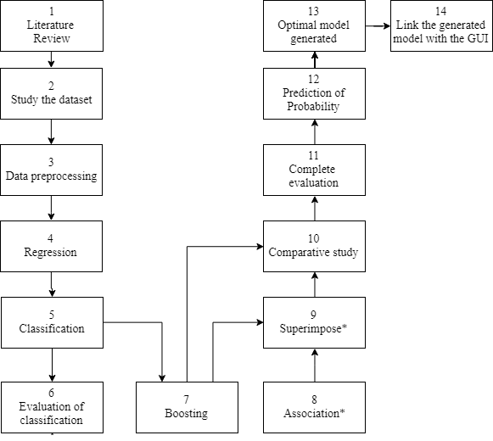
Project Block Diagram
Fig 1. Block diagram for project development stages

Slide 13
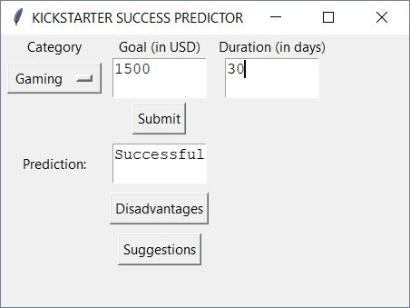
Implementation (GUI)
Fig 2. Basic GUI

Slide 14
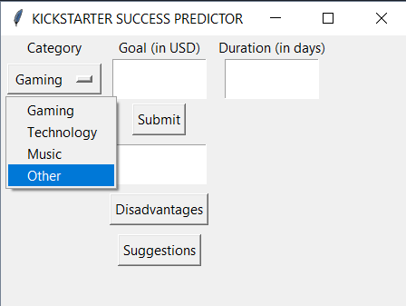
Implementation (GUI)
Fig 3. List of categories

Slide 15

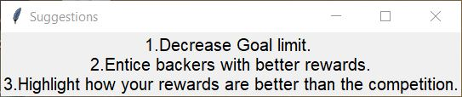
Implementation (GUI)
Fig 4. Disadvantages for given inputs
Fig 5. Suggestions for given input

Slide 16
Thank You

